Slide 1
Mine to Farm, supply-chain simulation JESA Strategy for Wave 2
User Guide
OCP Solutions for JESA
September 2019

Slide 2
Agenda
1
Installation
2
Global architecture
3
Model
4
Dashboard

Slide 3
Installation (mine2farm)
1
Instructions
This project is based on Python programming language.
Excel is the user interface used for inputs.
MongoDB is the preferred database program for storing and handling input and outputs of model.
These data are visualized using Tableau software.
In order to use the model on a Windows environment, you need to setup the following:

Slide 4
Installation (mine2farm)
1
Instructions
This project is based on Python programming language.
Excel is the user interface used for inputs.
MongoDB is the preferred database program for storing and handling input and outputs of model.
These data are visualized using Tableau software.
In order to use the model on a Windows environment, you need to setup the following:
Python
To be able to run the model, install Python 3.7.5 or above, download and run the .exe installer from: https://www.python.org/downloads/, follow instructions
To be able to manage packages requirements, install Anaconda, download and run the .exe installer from: https://www.anaconda.com/distribution/, follow instructions
To be able to access the code, Install PyCharm (IDE) Community edition, download and run the .exe installer from: https://www.jetbrains.com/pycharm/download/#section=windows, follow instructions

Slide 5
Installation (mine2farm)
1
Instructions
This project is based on Python programming language.
Excel is the user interface used for inputs.
MongoDB is the preferred database program for storing and handling input and outputs of model.
These data are visualized using Tableau software.
In order to use the model on a Windows environment, you need to setup the following:
Python
Go to git console and get the up-to-date version of the project by executing the following command: git clone https://DKAnass@bitbucket.org/mmakkouh/mine2farm.git
Install requirements mentioned in requirements.txt (automatically detected by PyCharm)

Slide 6
Installation (mine2farm)
1
Instructions
This project is based on Python programming language.
Excel is the user interface used for inputs.
MongoDB is the preferred database program for storing and handling input and outputs of model.
These data are visualized using Tableau software.
In order to use the model on a Windows environment, you need to setup the following:
MongoDB
To be able to store both inputs and outputs in distinct and reliable databases, install MongoDB by following the instructions here: https://docs.mongodb.com/v3.2/tutorial/install-mongodb-on-windows/
After installation, create the following directory: C:\data\db
add the following to you path environment variable: “C:\Program Files\MongoDB\Server\4.0\bin” TO BE DETAILED
To visualize data in database: download MongoDB Compass .exe installer from: https://www.mongodb.com/products/compass and follow the instructions

Slide 7
Installation (mine2farm)
1
Instructions
This project is based on Python programming language.
Excel is the user interface used for inputs.
MongoDB is the preferred database program for storing and handling input and outputs of model.
These data are visualized using Tableau software.
In order to use the model on a Windows environment, you need to setup the following:
Tableau
download Tableau software .exe installer from: https://tableau.com/products/trial/ and follow instructions. Please note that this is a trial version, a license can be purchased on Tableau website
Download and install MongoDB Connector for BI from official website https://www.mongodb.com/download-center/bi-connector/
Open "Program Files > MongoDB > Connector for BI > 2.12 > bin > mongosqld.exe" wait for connections then note the port and server used by mongoDb connector for BI
Open Tableau desktop then specify the server and port for connection

Slide 8





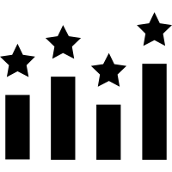




GLOBAL ARCHITECTURE
2
Canvas
Data Service
Data Layer
Data DB 1
Results DB 1
Analytics DB 1
Data DB N
Results DB N
Analytics DB N
Model Layer
DB Save Workers
Viz Layer
Ranking Module
Command
Monitoring Layer
Viz Analytics 1
Cache
Send results
Viz Analytics N
Monitor
Simulation Workers

Slide 9

GLOBAL ARCHITECTURE - Monitor
2
You can monitor the progress of the simulation and results workers with this component ,
They store their informations in a cache ,and the user can check from it the worker progress
Model Layer
DB Save Workers
Monitoring Layer
Send results
Simulation Workers
Monitor
Cache
Check health

Slide 10


GLOBAL ARCHITECTURE - Command
2
It contains a set of commands that :
Start the data service
Start the model
This component has two interactions , one with Data Service and another with the model
Canvas
Data Layer
Model Layer
Launch Data Service
DB Save Workers
Monitoring Layer
Launch model
Command
Send results
Simulation Workers

Slide 11
GLOBAL ARCHITECTURE – Ranking
2
Data Layer
Results DB 1
Data Service
Analytics DB 1
Results DB N
Analytics DB N
DB Save Workers
Ranking Module
Viz Layer
Viz Analytics 1
Among the calculations of all the scenarios, we choose the 100 best scenarios,
Simulation Workers
Viz Analytics N
Model Layer

Slide 12
GLOBAL ARCHITECTURE - Viz
2
Data Layer
Results DB 1
Data Service
Analytics DB 1
Results DB N
Analytics DB N
Viz Layer
Viz Analytics 1
We offer dashboards that help you make strategic decisions
Viz Analytics N

Slide 13
GLOBAL ARCHITECTURE
2
Canvas
Data Layer
Results DB 1
Data Service
Analytics DB 1
Data DB 1
Results DB N
Analytics DB N
Data DB N
Launch Data Service
DB Save Workers
Ranking Module
Viz Layer
Command
Monitoring Layer
Viz Analytics 1
Launch model
Monitor
Cache
Check health
Send results
Simulation Workers
Viz Analytics N
Model Layer

Slide 14
Model

Slide 15
The model follows a 3-step workflow
3
Select parameters
manualy
Canvas
Scenario data is saved in its own db
Start simulation
Simulation is run over each set of data
View results
Results appear in Tableau software for best 100 scenarios
Slide 27
Fill
Save
Canvas
Simulate
Save
Rank
Start simulation
Slide 16
Slide 30

Slide 16
Model
3
Objective
The main purpose of the model is to provide best scenarios of the supply-chain in terms of cost PV. It will compute also utilities, by-products and co-products balances.
Scope
The model will simulate multiple scenarios of processes, capacities and locations for mine, beneficiation, SAP, PAP, granulation and the underlying logistics that connects those layers. The scope of each layer is detailed in the following sections.
Optimization horizon
The strategic study of JESA is based on a 11-year investment horizon.
Python
Technology
Web APIs
Distributed computing
Mongo DB
16

Slide 17
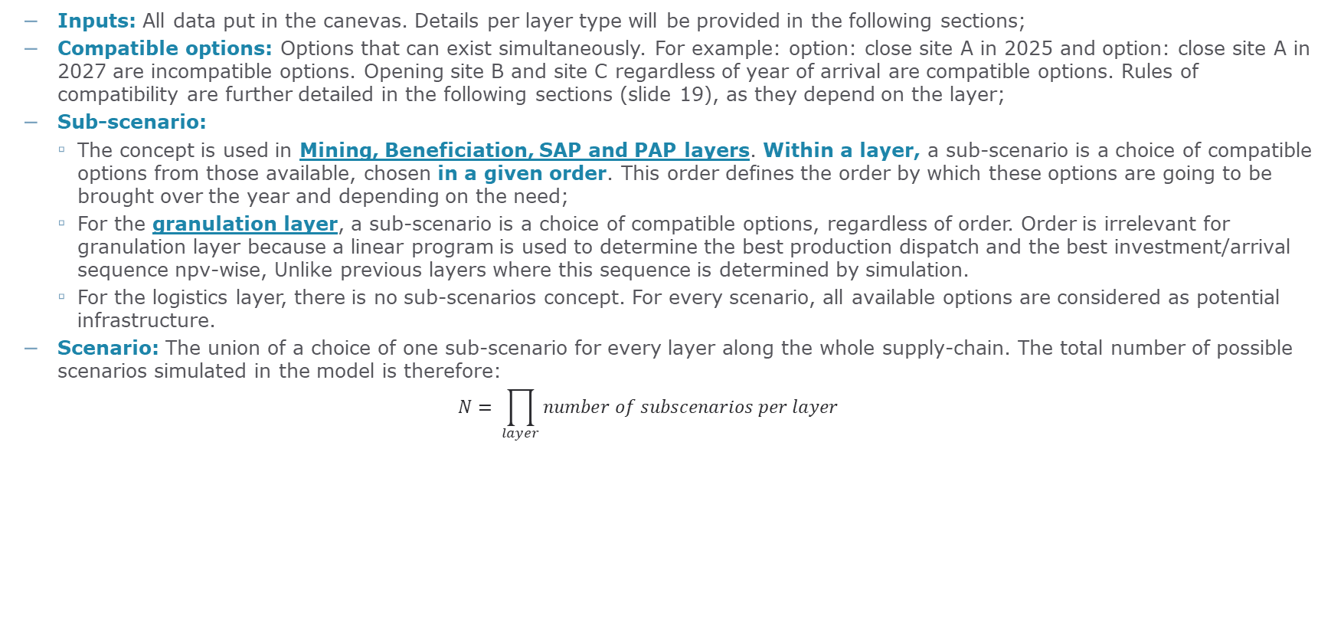
Terminologies
3
Inputs: All data put in the canevas. Details per layer type will be provided in the following sections;
Compatible options: Options that can exist simultaneously. For example: option: close site A in 2025 and option: close site A in 2027 are incompatible options. Opening site B and site C regardless of year of arrival are compatible options. Rules of compatibility are further detailed in the following sections (slide 19), as they depend on the layer;
Sub-scenario:
The concept is used in Mining, Beneficiation, SAP and PAP layers. Within a layer, a sub-scenario is a choice of compatible options from those available, chosen in a given order. This order defines the order by which these options are going to be brought over the year and depending on the need;
For the granulation layer, a sub-scenario is a choice of compatible options, regardless of order. Order is irrelevant for granulation layer because a linear program is used to determine the best production dispatch and the best investment/arrival sequence npv-wise, Unlike previous layers where this sequence is determined by simulation.
For the logistics layer, there is no sub-scenarios concept. For every scenario, all available options are considered as potential infrastructure.
Scenario: The union of a choice of one sub-scenario for every layer along the whole supply-chain. The total number of possible scenarios simulated in the model is therefore:
$$N= \prod_{layer}{number of subscenarios per layer}$$

Slide 18
Model architecture
3
Granulation solver
Determining best ferts production allocation and capex sequence for a given subscenario. Storing the data in the relevant granulation units
Creating « Entity » objects
Individual objects for every option available, containing all relevant related data (opex, capex, specific consumptions, etc.)
Creating sub-scenarios
For Mine/beneficiation, SAP,
PAP,
Granulation
Canvas inputs:
n.b: the first sheet of every layer contains the dictionary of elements used to ensure the homogeneity of data insered
Back-Propagation
Starting from granulation and the provided sales plan, every layer tries to produce the required quantities, and drives the previous layer to meet its demand. Example: ferts SP + ACP SP drive ACP layer production, ACP layer drives both Beneficiation and SAP layers, etc.
Results
Logistics solver
Once all material fluxes and production are determined, logistics solver determines best logistics scheme to satisfy these needs, while optimizing npv

Slide 19
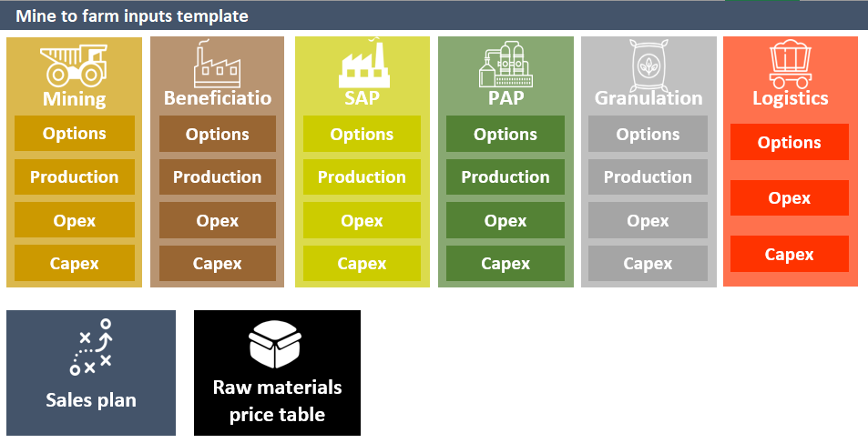

Creating « Entity » Objects
3
Granulation solver
Creating « Entity » objects
Creating sub-scenarios
Back-Propagation
Canvas
Inputs
Results
6 layers define the big blocks in the value chain of OCP:
Logistics solver
Note: every option must have matching data along the whole data spectrum.
Sales plan by product by year
The home page of the canvas has a navigation pane for each layer of the supply-chain. Each box redirects to the corresponding sheet. In each sheet, a home page button is present in the top left corner.
Raw material prices per year
19

Slide 20
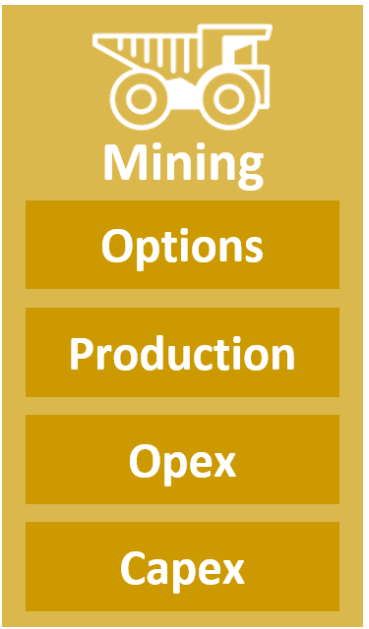
Creating « Entity » Objects: MineEntity
3
Granulation solver
Creating « Entity » objects
Creating sub-scenarios
Back-Propagation
Canvas
Inputs
Results
Logistics solver
Options: Every row corresponds to given option, defined by a unique ID (moniker), and contains the following columns:
Location: [string] is the location of the mine
Name: [string] is its name
Extraction: [string] defines the mode of extraction considered. This element is important because one could choose to compare two types of extraction method for the same mine
Capacity: [float] corresponds to yearly capacity
Status: [string], can be either “Existing”, “New”, or “Extension”
StartingDate: [int] year of potential arrival: the option can only be opened at the given year or any year after
ClosingDate: [int] year of closure: the option must close at ClosingDate

Slide 21
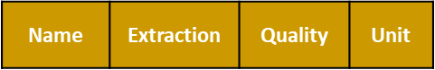
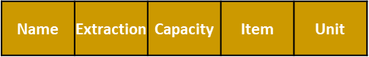
Creating « Entity » Objects: MineEntity
3
Granulation solver
Creating « Entity » objects
Creating sub-scenarios
Back-Propagation
Canvas
Inputs
Results
Logistics solver
Production: Every row gives a given quality content by name, location and extraction type:
Quality: [string] can be “HT”, “MT”, “BT”, “TBT”
Unit: [string] is %
Every option “picks” from these values the composition of rock extracted from it
Name | Extraction | Quality | Unit
Opex: Can contain both opex per ton extracted and specific consumption of any element, per mine name + extraction mode + capacity:
Item: [string] Item for which specific consumption is given (example: water, electricity, etc.), or the specific value “Total” to give opex directly. Note that if for a given option “Total” is provided, these values are considered as the opex. If not, opex is calculated as the sum of specific_consumption_per_item*its_price as provided in the prices table

Slide 22
Creating « Entity » Objects: MineEntity
3
Granulation solver
Creating « Entity » objects
Creating sub-scenarios
Back-Propagation
Canvas
Inputs
Results
Logistics solver
Capex: Every row gives the disbursement sequence for a specific option –defined by its name + extraction type + capacity- (whose status is either “New” or “Extension”:
A Capex can be split into several fragments (In case the user wishes to detail the capex structure or apply a different disbursement sequence for every part of it). In this case, the sum of the capex payment is calculated. If “Total” is in “Item” column for that specific capex, the corresponding line is considered the total capex
Item: [string] can be anything representing a part of a capex. A specific item is “Total”, which represents the total capex considered.
Currency: [string] currency of capex
-5 to 5 columns: every column i represents the year i before or after the capex. If such an option is considered in a scenario, column 0 would correspond to year of arrival, 1 to year of arrival + 1, etc.
Name | Extraction | Capacity | Item | Currency | CAPEX | -5 | … | 5
Name | Extraction | Quality | Unit

Slide 23
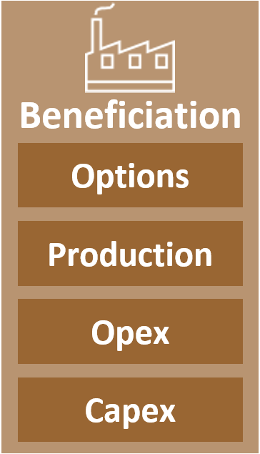
Creating « Entity » Objects: BeneficiationEntity
3
Granulation solver
Creating « Entity » objects
Creating sub-scenarios
Back-Propagation
Canvas
Inputs
Results
Logistics solver
Options: Every row corresponds to given option, defined by a unique ID (moniker), and contains the following columns:
Location: [string] is the location of the beneficiation
Name: [string] is its name
Process: [string] defines the beneficiation process considered.
Capacity: [float] corresponds to yearly capacity
Status: [string], can be either “Existing”, “New”, or “Extension”
StartingDate: [int] year of potential arrival: the option can only be opened at the given year or any year after
ClosingDate: [int] year of closure: the option must close at ClosingDate

Slide 24
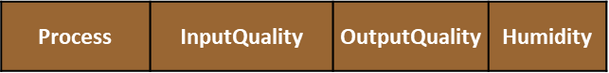
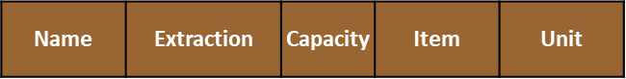
Creating « Entity » Objects: BeneficiationEntity
3
Granulation solver
Creating « Entity » objects
Creating sub-scenarios
Back-Propagation
Canvas
Inputs
Results
Logistics solver
Production: Every row gives the yield of a process (defined by %beneficiated rock/input rock) per process-input quality – output quality trio:
InputQuality: [string] can be “HT”, “MT”, “BT”, “TBT”. In all cases, it must match the qualities entered for the mines options that can be connected to the beneficiation option
OutputQuality: [string] The rock quality expected as output of process. Several rock outputs are possible.
Opex: Can contain both opex per ton extracted and specific consumption of any element, per process-input quality – output quality trio :
Item: [string] same as mine-opex

Slide 25
Creating « Entity » Objects: BeneficiationEntity
3
Granulation solver
Creating « Entity » objects
Creating sub-scenarios
Back-Propagation
Canvas
Inputs
Results
Logistics solver
Capex: Every row gives the disbursement sequence for a specific option –defined by its name + extraction type + capacity- (whose status is either “New” or “Extension”:
A Capex can be split into several fragments (In case the user wishes to detail the capex structure or apply a different disbursement sequence for every part of it). In this case, the sum of the capex payment is calculated. If “Total” is in “Item” column for that specific capex, the corresponding line is considered the total capex
Item: [string] can be anything representing a part of a capex. A specific item is “Total”, which represents the total capex considered.
Currency: [string] currency of capex
-5 to 5 columns: every column i represents the year i before or after the capex. If such an option is considered in a scenario, column 0 would correspond to year of arrival, 1 to year of arrival + 1, etc.

Slide 26
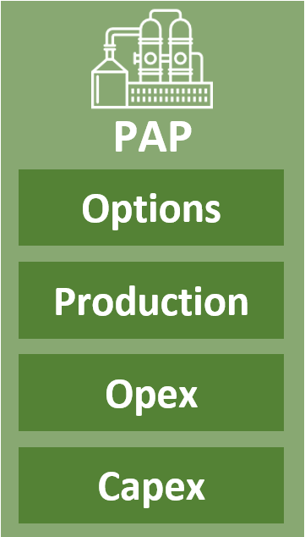
Creating « Entity » Objects: PapEntity
3
Granulation solver
Creating « Entity » objects
Creating sub-scenarios
Back-Propagation
Canvas
Inputs
Results
Logistics solver
Options: Every row corresponds to given option, defined by a unique ID (moniker), and contains the following columns:
Location: [string] is the location of the Phosphoric acid plant
Name: [string/int] is its name, if status is “Existing”, or the number of considered units of the same type, if status == “New”
Process: [string] defines the pap process considered.
Capacity: [float] corresponds to yearly capacity, expressed in tP2O5
Status: [string], can be either “Existing”, “New”
StartingDate: [int] year of potential arrival: the option can only be opened at the given year or any year after
ClosingDate: [int] year of closure: the option must close at ClosingDate

Slide 27
Creating « Entity » Objects: PapEntity
3
Granulation solver
Creating « Entity » objects
Creating sub-scenarios
Back-Propagation
Canvas
Inputs
Results
Logistics solver
Production: Every row gives how much production we get when producing one tP2O5, per pap process – rock quality at input:
Input: [string] rock type. These must match with those provided as beneficiation outputs
Product: [string] A mandatory input is “ACP 29”, with the default value of 1 tP2O5/tP2O5. One can put here any other product (Phosphogypsum, fluorine, etc.) for which a mass balance is requested. Note that “ACP 29” designs “ACP” both 29 and 54
Opex: Can contain both opex per ton P2O5 and/or specific consumption of any element, per location – process – capacity- input quality – output:
Item: [string] same as mine-opex

Slide 28
Creating « Entity » Objects: PapEntity
3
Granulation solver
Creating « Entity » objects
Creating sub-scenarios
Back-Propagation
Canvas
Inputs
Results
Logistics solver
Capex: Every row gives the disbursement sequence for a specific option –defined by its location + process +capacity (whose status is “New”:
A Capex can be split into several fragments (In case the user wishes to detail the capex structure or apply a different disbursement sequence for every part of it). In this case, the sum of the capex payment is calculated. If “Total” is in “Item” column for that specific capex, the corresponding line is considered the total capex
Item: [string] can be anything representing a part of a capex. A specific item is “Total”, which represents the total capex considered.
Currency: [string] currency of capex
CAPEX: [int] amount of capex for given item
-5 to 5 columns: [%] every column i represents the year i before or after the capex. If such an option is considered in a scenario, column 0 would correspond to year of arrival, 1 to year of arrival + 1, etc.

Slide 29
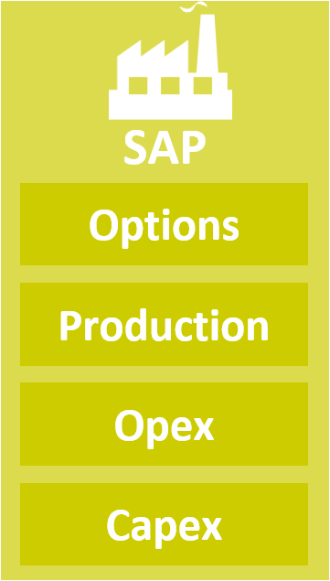
Creating « Entity » Objects: SapEntity
3
Granulation solver
Creating « Entity » objects
Creating sub-scenarios
Back-Propagation
Canvas
Inputs
Results
Logistics solver
Options: Every row corresponds to given option, defined by a unique ID (moniker), and contains the following columns:
Location: [string] is the location of the Sulfuric acid plant
Name: [string/int] is its name, if status is “Existing”, or the number of considered units of the same type, if status == “New”
Process: [string] defines the sap process considered.
Capacity: [float] corresponds to yearly capacity
Status: [string], can be either “Existing”, “New”
Associated_pap: [string] corresponds to the moniker of one of the paps. This columns is used exclusively for “Existing” option that can potentially be closed. We suppose that the industrial complex is closed as a whole, and therefore both pap and sap must close at the same year. Pap_associated points to the pap that closes with this sap option
StartingDate: [int] year of potential arrival: the option can only be opened at the given year or any year after
ClosingDate: [int] year of closure: the option must close at ClosingDate

Slide 30
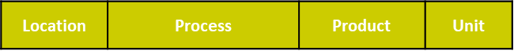
Creating « Entity » Objects: SapEntity
3
Granulation solver
Creating « Entity » objects
Creating sub-scenarios
Back-Propagation
Canvas
Inputs
Results
Logistics solver
Production: Every row gives how much production we get of “Product” when producing one tACS, per sap process – location:
Product: [string] A mandatory input is “ACS”, with the default value of 1 t/tProduced. One can put here any other product (ex. Electricity) for which a balance is requested.
Opex: Can contain both opex per ton and/or specific consumption of any element, per location – process:
Item: [string] same as mine-opex
Location | Process | Item | Unit

Slide 31
Creating « Entity » Objects: SapEntity
3
Granulation solver
Creating « Entity » objects
Creating sub-scenarios
Back-Propagation
Canvas
Inputs
Results
Logistics solver
Capex: Every row gives the disbursement sequence for a specific option –defined by its location + process + capacity (whose status is “New”):
A Capex can be split into several fragments (In case the user wishes to detail the capex structure or apply a different disbursement sequence for every part of it). In this case, the sum of the capex payment is calculated. If “Total” is in “Item” column for that specific capex, the corresponding line is considered the total capex
Item: [string] can be anything representing a part of a capex. A specific item is “Total”, which represents the total capex considered.
Currency: [string] currency of capex
CAPEX: [int] amount of capex for given item
-5 to 5 columns: [%] every column i represents the year i before or after the capex. If such an option is considered in a scenario, column 0 would correspond to year of arrival, 1 to year of arrival + 1, etc.

Slide 32
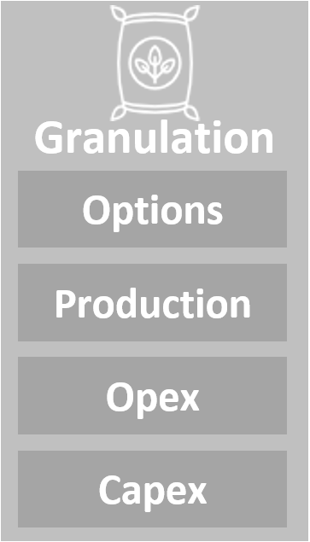
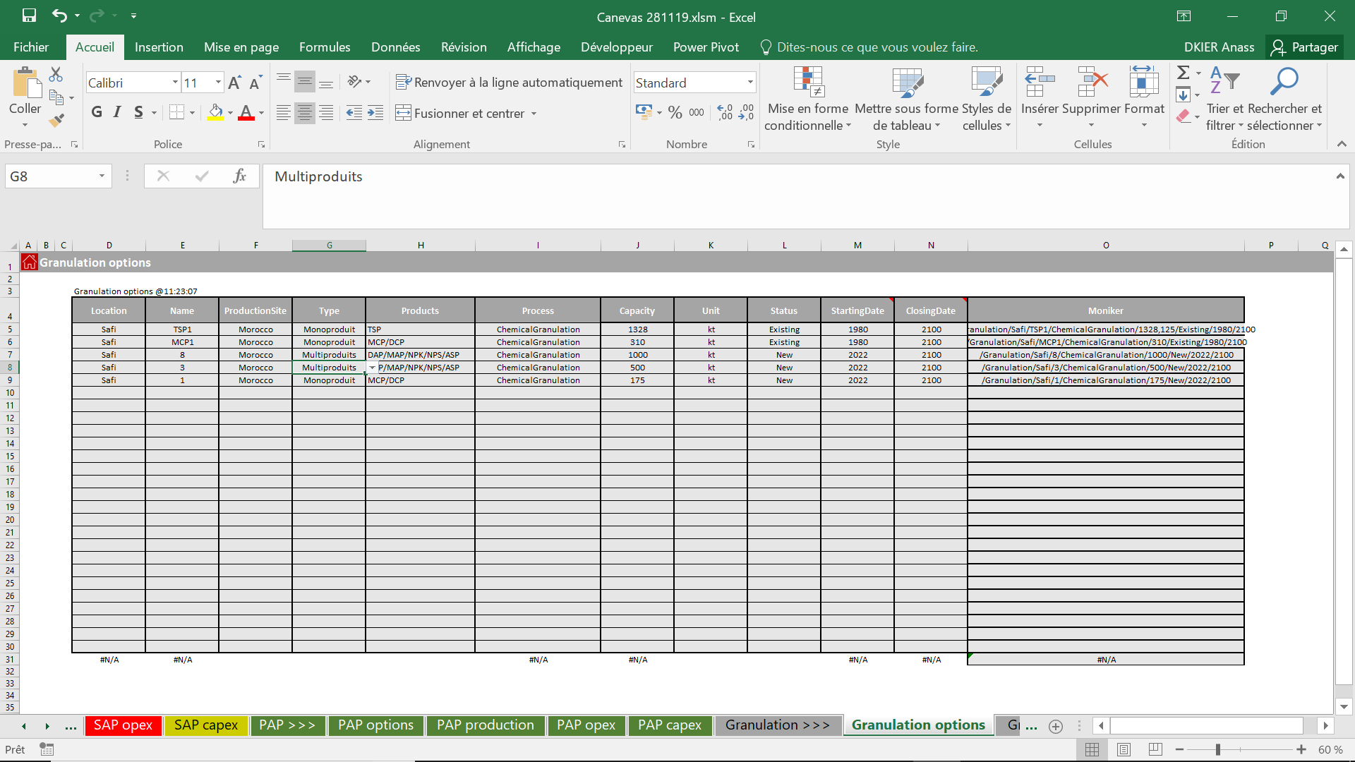
Creating « Entity » Objects: GranulationEntity
3
Granulation solver
Creating « Entity » objects
Creating sub-scenarios
Back-Propagation
Canvas
Inputs
Results
Logistics solver
Options: Every row corresponds to given option, defined by a unique ID (moniker), and contains the following columns:
Location: [string] is the location of the granulation plant
Name: [string/int] is its name, if status is “Existing”, or the number of considered units of the same type, if status == “New”
ProductionSite: [string] either “Morocco” or “Abroad”
Type: [string] either “Monoproduit” or “Multiproduits”, describes whether the unit can produce more than one fertilizer or it is a specialized line.
Products: [string] gives list of products considerd un the option, separated by “/” (ex. DAP/MAP, DAP/MAP/NPK);
Process: [string] defines the granulation process considered;

Slide 33
Creating « Entity » Objects: GranulationEntity
3
Granulation solver
Creating « Entity » objects
Creating sub-scenarios
Back-Propagation
Canvas
Inputs
Results
Logistics solver
Options: Every row corresponds to given option, defined by a unique ID (moniker), and contains the following columns:
Capacity: [float] corresponds to yearly capacity, it is expressed in DAP-equivalent term, even when the plant is specified;
Unit: [string], unit
Status: [string], can be either “Existing”, “New”
StartingDate: [int] year of potential arrival: the option can only be opened at the given year or any year after
ClosingDate: [int] year of closure: the option must close at ClosingDate

Slide 34
Creating « Entity » Objects: GranulationEntity
3
Granulation solver
Creating « Entity » objects
Creating sub-scenarios
Back-Propagation
Canvas
Inputs
Results
Logistics solver
Production: Every row gives granulation ratios (expressed as tProduct/tDAP), per granulation process – phosphoric acid type input – fertilizer produced:
Opex: Can contain both opex per ton and/or specific consumption of any element, per location – process – capacity - product:
Item: [string] same as mine-opex

Slide 35
Creating « Entity » Objects: GranulationEntity
3
Granulation solver
Creating « Entity » objects
Creating sub-scenarios
Back-Propagation
Canvas
Inputs
Results
Logistics solver
Capex: Every row gives the disbursement sequence for a specific option –defined by its location + process + capacity (whose status is “New”):
A Capex can be split into several fragments (In case the user wishes to detail the capex structure or apply a different disbursement sequence for every part of it). In this case, the sum of the capex payment is calculated. If “Total” is in “Item” column for that specific capex, the corresponding line is considered the total capex
Item: [string] can be anything representing a part of a capex. A specific item is “Total”, which represents the total capex considered.
Currency: [string] currency of capex
CAPEX: [int] amount of capex for given item
-5 to 5 columns: [%] every column i represents the year i before or after the capex. If such an option is considered in a scenario, column 0 would correspond to year of arrival, 1 to year of arrival + 1, etc.

Slide 36
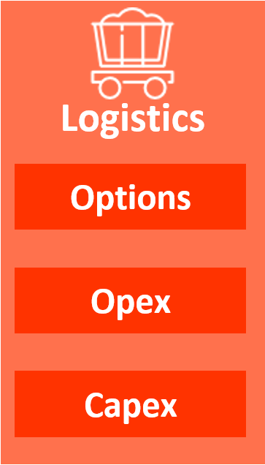
Creating « Entity » Objects: LogisticsEntity
3
Granulation solver
Creating « Entity » objects
Creating sub-scenarios
Back-Propagation
Canvas
Inputs
Results
Logistics solver
Options: Every row corresponds to given option, defined by a unique ID (moniker), and contains the following columns:
Name: [string/int] is its name,
Upstream: [string] starting point of infrastructure;
Downstream: [string] end point of infrastructure;
LayerTolayer: [string] specifies what are the two layers connected with the sais infrastructure. Can be within the same layer;
PAPLocation: [string] contains information of when to consider the option depending on the scenario chosen. PAPLocation is where new PAPs are going to be built;
Method: [float] either “Pipeline”, “Train”, or “Conveyor”
Product: [float] corresponds to transported product class: “Rock”, “Acid”, etc.
Capacity: [float] corresponds to yearly capacity,
Status: [string], can be either “Existing”, “New”
StartingDate: [int] year of potential arrival: the option can only be opened at the given year or any year after
ClosingDate: [int] year of closure: the option must close at ClosingDate
Name | Upstream | Downstream | Method | Product | Capacity | Status | StartingDate | ClosingDate | Moniker

Slide 37
Creating « Entity » Objects: LogisticsEntity
3
Granulation solver
Creating « Entity » objects
Creating sub-scenarios
Back-Propagation
Canvas
Inputs
Results
Logistics solver
Opex: Can contain both opex per ton and/or specific consumption of any element, per upstream – downstream –method - capacity:
Item: [string] same as mine-opex
Upstream | Downstream | Method | Product | Capacity | Item | Unit

Slide 38
Creating « Entity » Objects: LogisticsEntity
3
Granulation solver
Creating « Entity » objects
Creating sub-scenarios
Back-Propagation
Canvas
Inputs
Results
Logistics solver
Capex: Every row gives the disbursement sequence for a specific option –defined by its upstream-downstream + method + capacity (whose status is “New”):
A Capex can be split into several fragments (In case the user wishes to detail the capex structure or apply a different disbursement sequence for every part of it). In this case, the sum of the capex payment is calculated. If “Total” is in “Item” column for that specific capex, the corresponding line is considered the total capex
Item: [string] can be anything representing a part of a capex. A specific item is “Total”, which represents the total capex considered.
Currency: [string] currency of capex
CAPEX: [int] amount of capex for given item
-5 to 5 columns: [%] every column i represents the year i before or after the capex. If such an option is considered in a scenario, column 0 would correspond to year of arrival, 1 to year of arrival + 1, etc.
Upstream | Downstream | Method | Product | Capacity | Item | Currency | CAPEX | -5 | … | 5

Slide 39
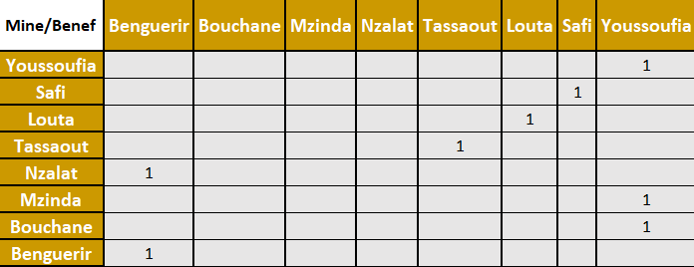
Creating « Entity » Objects: MineBeneficiationEntity
3
Granulation solver
Creating « Entity » objects
Creating sub-scenarios
Back-Propagation
Canvas
Inputs
Results
Logistics solver
Mines and Beneficiation are connectable via a connection matrix M:
A mine and a beneficiation site can be connected if and only if M[mine_location, beneficiation_location] == 1
The cost of beneficiation depends on the rock composition at input, i.e. depends on the mine. Therefore, we define a new entity object: MineBeneficiationEntity

Slide 40
Creating « Entity » Objects: MineBeneficiationEntity
3
Granulation solver
Creating « Entity » objects
Creating sub-scenarios
Back-Propagation
Canvas
Inputs
Results
Logistics solver
The parameters of the new entity are calculated as ponderations by the mine composition.
Example: calculation of opex:
Beneficiating HT rock costs 1, MT costs 2, BT costs 3 and TBT costs 4
Mine composition is 10% HT, 40% BT and 50% TBT
➔ OPEX(MINE, BENEFICIATION) = 10%*1+ 40%*3 + 50%*4
Same logic applies to consumption, production etc.

Slide 41
Creating sub-scenarios: Mines and Beneficiations
3
Granulation solver
Creating « Entity » objects
Creating sub-scenarios
Back-Propagation
Canvas
Inputs
Results
Logistics solver
Mines and Beneficiations are specific entities, in the way that it’s the only entity types to have Extensions.
Extension only occurs when there’s need for additional capacity. Once this happens, the parameters of the extended entity are considered.
Conditions of options compatibility: In a logical Mine-Beneficiation sub-scenario:
The name of a given mine occurs only once, i.e. there’s only one entity whose name is “Benguerir 1” for example. A given location can have many mines open in the same scenario;
Similarly, the name of a given Beneficiation occurs only once;
A mine can be connected to only one Beneficiation entity;
A beneficiation entity can take as input several mines;
A beneficiation capacity should be able to beneficiate all the capacity of connected mines; i.e. Sum(mines capacities)<=Beneficiation capacity

Slide 42
Creating sub-scenarios: Mines and Beneficiations
3
Granulation solver
Creating « Entity » objects
Creating sub-scenarios
Back-Propagation
Canvas
Inputs
Results
Logistics solver
Suppose we have constructed all the possible mine-beneficiation compatible combinations.
Priority mines concept: The locations written in the table “priority_mines” give an eventual list of mines tat the user would want to open before considering other hands.
Their production comes always first, they are saturated before considering production in other mines
Their extensions (if there are any) are considered before opening new mines
Creating mine-beneficiation sub-scenarios:
Production allocation and opening of entities is done respecting the order of entities considered in a given layer. This holds true for Mine-Beneficiation layer
We isolate the options containing priority mines and put them first
We consider every possible permutation of the other options. Every permutation (+ the static priority mines) is going to be a distinct mine-beneficiation sub-scenario.

Slide 43
Creating sub-scenarios: PAP
3
Granulation solver
Creating « Entity » objects
Creating sub-scenarios
Back-Propagation
Canvas
Inputs
Results
Logistics solver
PAP options contain named options (existing) and new unnamed options with a number associated;
The new potential options are duplicated in as much entities as needed;
Conditions of options compatibility: In a logical PAP sub-scenario:
All new PAP entities are in the same location;
All new PAP entities are of the same process;
Choices of options for existing units should be coherent, example: within a compatible group, when there are many options for the same entity (different closing dates for example), there’s only one choice per existing entity.

Slide 44
Creating sub-scenarios: PAP
3
Granulation solver
Creating « Entity » objects
Creating sub-scenarios
Back-Propagation
Canvas
Inputs
Results
Logistics solver
Suppose we have constructed all the possible PAP combinations.
Creating PAP sub-scenarios:
Production allocation and opening of entities is done respecting the order of entities considered in a given layer. This holds true for PAP layer
We isolate the options with “Existing” status and put them first: they are therefore saturated before considering new investments.
We consider every possible permutation of the “New”-labeled options. This gives potentially rise to a huge amount of options that makes the computation too heavy. Therefore, we reduce the number of options by doing the following:
PAP sub-scenarios number reduction:
Compute all possible phosphoric needs (those depend actually on the choices made for granulation also)
Compute all possible permutations of all groups of compatible options
Build “baskets” of permutations, where all options have the same process and the same location
Within a basket, For every ACP needs possibility, for every permutation, the production and investment needed are simulated locally, and compared npv-wise.
We only keep a determined number of permutations (default value = 1) for every basket. This approach is justified by the fact that we can completely isolate the PAP layer from the rest of supply-chain, provided we know the location and process chosen.

Slide 45
Creating sub-scenarios: SAP
3
Granulation solver
Creating « Entity » objects
Creating sub-scenarios
Back-Propagation
Canvas
Inputs
Results
Logistics solver
Everything that applies for PAP is valid for SAP layer

Slide 46
Creating sub-scenarios: reconciling PAP and SAP
3
Granulation solver
Creating « Entity » objects
Creating sub-scenarios
Back-Propagation
Canvas
Inputs
Results
Logistics solver
Conditions of options compatibility: In a coherent scenario, PAP and SAP layers are in reality dependent:
They are located in the same location
Closing options should be coherent: if, within a scenario, the SAP branch of an entity closes in year x, PAP within the same scenario should close as well in the same year.
Any scenario not satisfying these two conditions is considered as invalid, these scenarios are therefore discarded before going to the next stage

Slide 47
Creating sub-scenarios: Granulation
3
Granulation solver
Creating « Entity » objects
Creating sub-scenarios
Back-Propagation
Canvas
Inputs
Results
Logistics solver
Granulation options contain named options (existing) and new unnamed options with a number associated;
The new potential options are duplicated in as much entities as needed;
There are two specific types of granulations: granulations existing, which are handled in the same way as PAP/SAP, and abroad entities
Conditions of options compatibility: In a logical Granulation scenario:
All new granulations entities are in the same location;
All new granulations entities are of the same process;
Choices of options for existing units should be coherent, example: within a compatible group, when there are many options for the same entity (different closing dates for example), there’s only one choice per existing entity.
Creating granulation sub-scenarios:
Every possible scenario = possible scenario for existing + possible scenario for new + possible scenario for abroad entities
Possible scenarios for abroad entities are all possible combinations of abroad entities considered. Once they are chosen in a scenario, their production is set to their capacity.
There is no order notion for granulation layer, as calculation is performed via a solver.

Slide 48
Creating scenarios: from Mine to PAP
3
Granulation solver
Creating « Entity » objects
Creating sub-scenarios
Back-Propagation
Canvas
Inputs
Results
Logistics solver
Creation of scenarios: All possible scenarios from Mine to PAP are created by “multiplying” the valid mine-beneficiation sub-scenarios and the valid sap-pap sub-scenarios

Slide 49
Calculation: overview
3
Granulation solver
Creating « Entity » objects
Creating sub-scenarios
Back-Propagation
Canvas
Inputs
Results
Granulation solver
Logistics solver
Granulation sales plan
Suppose we take a given granulation sub-scenario S_G and a given mine-to-pap scenario:
We start by saturating the abroad entities present in S_G, and subtract it from granulation sales plan, while adding its acid needs to acid sales plan.
Solver is run on existing + new granulation entities;
Acid needs are computed + TSP rock needs. These go into PAP model as a driver. Every layer tries to satisfy the demand if the said layer produces the product, or passes it to the layer before if it doesn’t. Moreover the demand satisfied creates a need for another product (example: acid production causes rock and sulfuric acid need, that are passed on to previous layers –SAP, Beneficiation and Mine-): This is what we call back-propagation.
Once all demands are satisfied and backpropagation stopped, logistics solver is run with all the options available, to determine best infrastructure map to satisfy the material fluxes
Ferts acid needs and TSP rock needs
Back-Propagation
Phosphoric acid sales plan
Rock sales plan
Computed production and material fluxes
Logistics solver

Slide 50
Granulation solver: model description
Granulation solver
Creating « Entity » objects
Creating sub-scenarios
Back-Propagation
Canvas
Inputs
Results
Logistics solver

Slide 51
Decision variables: granularity and notation
Variable | Type | Description | Granularity | Notation
ProdExist | Float | Production by year by product by existing entity | /year/Product/Entity | ProdExist[year][product][entity]
ProdNew | Float | Production by year by product by new entity | /year/Product/Entity | ProdNew[year][product][entity]
Inv | Binary | Binary variable of investment in an entity during a year | /year /Entity | Inv[year][entity]

Slide 52
Parameters: granularity and notation
Parameters | Description | Granularity | Notation
Demand | Demand by product by year | /Year /Product | Demand[year][product]
Capacity | The capacity of an entity in DAP equivalent | /Entity/Year | Capa[entity][year]
Granulation ratio | The granulation ratio of the process by product | /Product/Year | RatioGranulation[product][year]
Products | Products that can be produced by an entity | /Entity | Products[entity]
Capex | Capex in figures by entity | /Entity | Capex[entity]
Capex_y | The percentage of the capex that must be injected "y" years before going into production | /Entity | Capex_y[entity]
Opex | Operational cost per tonne per entity by product | /Entity/Product | Opex[entity][product]
WACC | The discount rate |  | WACC

Slide 53
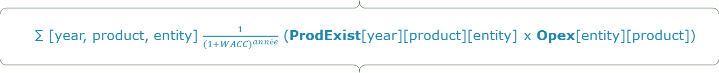
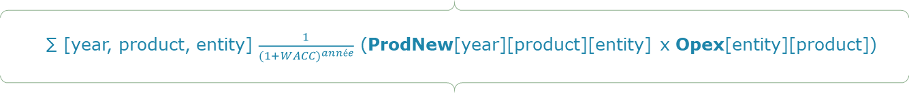
The model satisfies the demand while minimizing the cost
∑ [year, product, entity] $\frac{1}{{(1+WACC)}^{année}}$ (ProdExist[year][product][entity] x Opex[entity][product])
Operational costs of the existing
Operational cost of production of the existing
∑ [year, product, entity] $\frac{1}{{(1+WACC)}^{année}}$ (ProdNew[year][product][entity] x Opex[entity][product])
1
∑ [year, entity] $\frac{1}{{(1+WACC)}^{année}}$ (Inv[year+3][entity] x Capex_3[entity] + Inv[year+2][entity] x Capex_2[entity] + Inv[year+1][entity] x Capex_1[entity] + Inv[year][entity] x Capex_0[entity])
Costs
Operational costs of news
Operational cost of new entities
Objective function: Minimize the total discounted cost
2
Investment costs
Investment cost of new entities
3
Operational costs of the existing
1
Operational costs of news
2
Investment costs
3

Slide 54
Constraints of the model
Idea | Mathematical formulation
The sum of the outputs of the existing entities and those of the new entities must be equal to the demand | ∑[entity] (ProdExist[year][product][entity] + ProdNew[year][product][entity]) = Demand[year][product]
The sum of productions by product of an existing entity should not exceed the capacity of the entity | ∑[product] ProdExist[year][product][entity] * 1/RatioGranulation[product][year] ≤ Capa[entity][year]
The sum of productions by product of a new entity should not exceed the capacity of the entity if it exists | ∑[product] ProdNew[year][product][entity] * 1/RatioGranulation[product][year] ≤ ∑[year<=year i] Inv[year][entity] * Capa[entity][year]
Investment in a unit is only once | ∑[year] Inv[year][entity] ≤ 1

Slide 55
Backpropagation: model description
Granulation solver
Creating « Entity » objects
Creating sub-scenarios
Back-Propagation
Canvas
Inputs
Results
Logistics solver

Slide 56
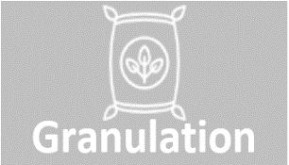
Back propagation relies on the input data being fully and correctly written
Back-propagation starts from solver results and ends with computing mine productions
Back-propagation is a dynamic process: it computes volumes at consumptions and tries to back-propagate them. Therefore, it I necessary to have the big blocks (example: “Chimie”, “ACP 29”, etc.), to ensure propagation is done correctly.
Mass, energy and water balances are done dynamically, a balance is made for every item introduced in consumption at a given stage.
Consumptions
Productions
Consumptions
Productions
Consumptions
Productions
Consumptions
Productions
Consumptions
Productions
Raw Rock
Rock
S.acid
Rock
Acid
Solver

Slide 57
Logistics solver: model description
Granulation solver
Creating « Entity » objects
Creating sub-scenarios
Back-Propagation
Canvas
Inputs
Results
Logistics solver

Slide 58
Decision variables: granularity and notation(1/2)
Variable | Type | Description | Granularity | Notation
ExistingTrainVolume | Float | Volume transported by an existing train per product per year per production location and consumption location | /Product/Mean/Prod location/Conso location/Year | ExistTrainV[Product][Mean][Prod location][Conso location][Year]
ExtensionTrainVolume | Float | Volume carried by a train with product extension per year per production location and consumption location | /Product/Mean/Prod location/Conso location/Year | ExtTrainV[Product][Mean][Prod location][Conso location][Year]
NewTrainVolume | Float | Volume transported by new train per product per year per production location and consumption location | /Product/Mean/Prod location/Conso location/Year | NewTrainV[Product][Mean][Prod location][Conso location][Year]
TrainExtension | Binary | Binary variable showing the investment in a train extension per production location and consumption location per year | /Mean/Prod location/Conso location/Year | TrainExt[Mean][Prod location][Conso location][Year]
TrainInvestment | Binary | Binary variable showing investment in a new train line per production location and consumption location per year | /Mean/Prod location/Conso location/Year | TrainInv[Mean][Prod location][Conso location][Year]

Slide 59
Decision variables: granularity and notation(2/2)
Variable | Type | Description | Granularity | Notation
ExistingPipeVolume | Float | Volume transported by an existing pipe by product per year per production location and consumption location | /Product/Mean/Prod location/Conso location/Year | ExistPipeV[Product][Mean][Prod location][Conso location][Year]
NewPipeVolume | Float | Volume transported by new pipe per product per year per production location and consumption location | /Product/Mean/Prod location/Conso location/Year | NewPipeV[Product][Mean][Prod location][Conso location][Year]
PipeInvestment | Binary | Binary variable showing investment in a new pipe per production location and consumption location per year | /Mean/Prod location/Conso location/Year | PipeInv[Mean][Prod location][Conso location][Year]
ExistingConveyorVolume | Float | Volume transported by an existing conveyor per product per year per production location and consumption location | /Product/Mean/Prod location/Conso location/Year | ExistConvV[Product][Mean][Prod location][Conso location][Year]
NewConveyorVolume | Float | Volume conveyed by a new conveyor per product per year per production location and consumption location | /Product/Mean/Prod location/Conso location/Year | NewConvV[Product][Mean][Prod location][Conso location][Year]
ConveyorInvestment | Binary | Binary variable showing investment in a new conveyor per production location and consumption location per year | /Mean/Prod location/Conso location/Year | ConvInv[Mean][Prod location][Conso location][Year]

Slide 60
Parameters: granularity and notation
Settings | Description | Granularity | Notation
Demand | Consumption per product per consumption location per year | /Product/Conso location/Year | Conso[Product][Conso location][Year]
Production | Production per product per location per year | /Product/Prod location/Year | Prod[Product][Prod location][Year]
Capacity | The capacity of a means of transport whether Train, Pipe or Conveyor | /Mean | Capa[Mean]
Products | Products that can be transported | /[Prod location][Conso location] | Products[Prod location][Conso location]
Capex | The capex in figures by means of transport whether it is Train, Pipe or Conveyor | /Mean | Capex[Mean]
Capex_y | The percentage of the capex that must be injected "y" years before going into production | /Mean | Capex_y[Mean]
Opex | Operational cost per tonne by means of transport | /Mean | Opex[Mean]
WACC | The discount rate |  | WACC

Slide 61
The model satisfies the demand while minimizing the cost
Operational costs of trains
Operational cost of transporting products by train
1
Operational costs of pipelines
Operational cost of product transportation through the pipeline
2
Objective function: Minimize the total discounted cost
Costs
Operational costs of conveyors
Operational cost of transporting products by the conveyor
3
Investment costs
Cost of extensions
Cost of new wherewithal
4
Notes:
Normalement pour la V2 du PL :
L’opex du pipeline est fixe et est donc égal à un opex/m3 * le volume du pipe
Et on devrait prendre en compte le coût de l’eau que je consomme si je n’envoie pas de la pulpe et dans ce cas on peut faire l’hypothèse que je consomme V = Vcapa – Vpulpe (à multiplier par un ratio inférieur à 1 qui doit être calculé par la team logistics) et que je multiplierai par un cout et ajouterai à la fonction objective

Slide 62
The model satisfies the demand while minimizing the cost
∑ [Product, Mean, Prod location, Conso location, Year] $\frac{1}{{(1+WACC)}^{Year}}$ (( ExistTrainV[Product][Mean][Prod location][Conso location][Year]xOpex[Mean])+ ExtTrainV[Product][Mean][Prod location][Conso location][Year]xOpex[Mean])+( NewTrainV[Product][Mean][Prod location][Conso location][Year]xOpex[Mean]))
∑ [Product, Mean, Prod location, Conso location, Year] $\frac{1}{{(1+WACC)}^{Year}}$ (( ExistPipeV[Product][Mean][Prod location][Conso location][Year]xOpex[Mean])+( NewPipeV[Product][Mean][Prod location][Conso location][Year]xOpex[Mean]))
∑ [Product, Mean, Prod location, Conso location, Year] $\frac{1}{{(1+WACC)}^{Year}}$ (( ExistConvV[Product][Mean][Prod location][Conso location][Year]xOpex[Mean])+( NewConvV[Product][Mean][Prod location][Conso location][Year]xOpex[Mean]))
∑ [Mean, Prod location, Conso location, Year] $\frac{1}{{(1+WACC)}^{Year}}$ ((TrainExt[Mean][Prod location][Conso location][Year+3]xCapex_3[Mean]+TrainExt[Mean][Prod location][Conso location][Year+2]xCapex_2[Mean]+TrainExt[Mean][Prod location][Conso location][Year+1]xCapex_1[Mean]+TrainExt[Mean][Prod location][Conso location][Year]xCapex_0[Mean])+(TrainInv[Mean][Prod location][Conso location][Year+3]xCapex_3[Mean]+TrainInv[Mean][Prod location][Conso location][Year+2]xCapex_2[Mean]+TrainInv[Mean][Prod location][Conso location][Year+1]xCapex_1[Mean]+TrainInv[Mean][Prod location][Conso location][Year]xCapex_0[Mean])+(PipeInv[Mean][Prod location][Conso location][Year+3]xCapex_3[Mean]+PipeInv[Mean][Prod location][Conso location][Year+2]xCapex_2[Mean]+PipeInv[Mean][Prod location][Conso location][Year+1]xCapex_1[Mean]+PipeInv[Mean][Prod location][Conso location][Year]xCapex_0[Mean])+(ConvInv[Mean][Prod location][Conso location][Year+3]xCapex_3[Mean]+ConvInv[Mean][Prod location][Conso location][Year+2]xCapex_2[Mean]+ConvInv[Mean][Prod location][Conso location][Year+1]xCapex_1[Mean]+ConvInv[Mean][Prod location][Conso location][Year]xCapex_0[Mean]))
1
2
3
4

Slide 63
Constraints of the model
Idea | Mathematical formulation
The sum of the volumes transported from a product to a consumption location per year is greater than or equal to the consumption of the product's location | ∑[Mean, Prod location] (ExistTrainV[Product][Mean][Prod location][Conso location][Year] + ExtTrainV[Product][Mean][Prod location][Conso location][Year] + NewTrainV[Product][Mean][Prod location][Conso location][Year] + ExistPipeV[Product][Mean][Prod location][Conso location][Year] + NewPipeV[Product][Mean][Prod location][Conso location][Year] + ExistConvV[Product][Mean][Prod location][Conso location][Year] + NewConvV[Product][Mean][Prod location][Conso location][Year]) ≥ Conso[Product][Conso location][Year]
The volume carried by an existing means of transport must be less than or equal to its capacity (Same thing for the pipe and convoy it) | ∑[Product] ExistTrainV[Product][Mean][Prod location][Conso location][Year] ≤ Capa[Mean]
The volume transported by a new means of transport must be less than or equal to its capacity from the moment that the investment in this means has been made (Same for the pipe and the conveyor and also valid for the extension of the trains) | ∑[Product] NewTrainV[Product][Mean][Prod location][Conso location][Year] ≤ Capa[Mean]*∑[Year<=Year i] (TrainInv[Mean][Prod location][Conso location][Year])
Investment in a means is only one time | ∑[Year] TrainInv[Mean][Prod location][Conso location][Year] ≤ 1
The volume transported by a means of transport of a product from a production location to a consumption location must be greater than or equal to the production of that location | ∑[Mean] (ExistTrainV[Product][Mean][Prod location][Conso location][Year] + ExtTrainV[Product][Mean][Prod location][Conso location][Year] + NewTrainV[Product][Mean][Prod location][Conso location][Year] + ExistPipeV[Product][Mean][Prod location][Conso location][Year] + NewPipeV[Product][Mean][Prod location][Conso location][Year] + ExistConvV[Product][Mean][Prod location][Conso location][Year] + NewConvV[Product][Mean][Prod location][Conso location][Year]) ≥ Prod[Product][Prod location][Year]

Slide 64
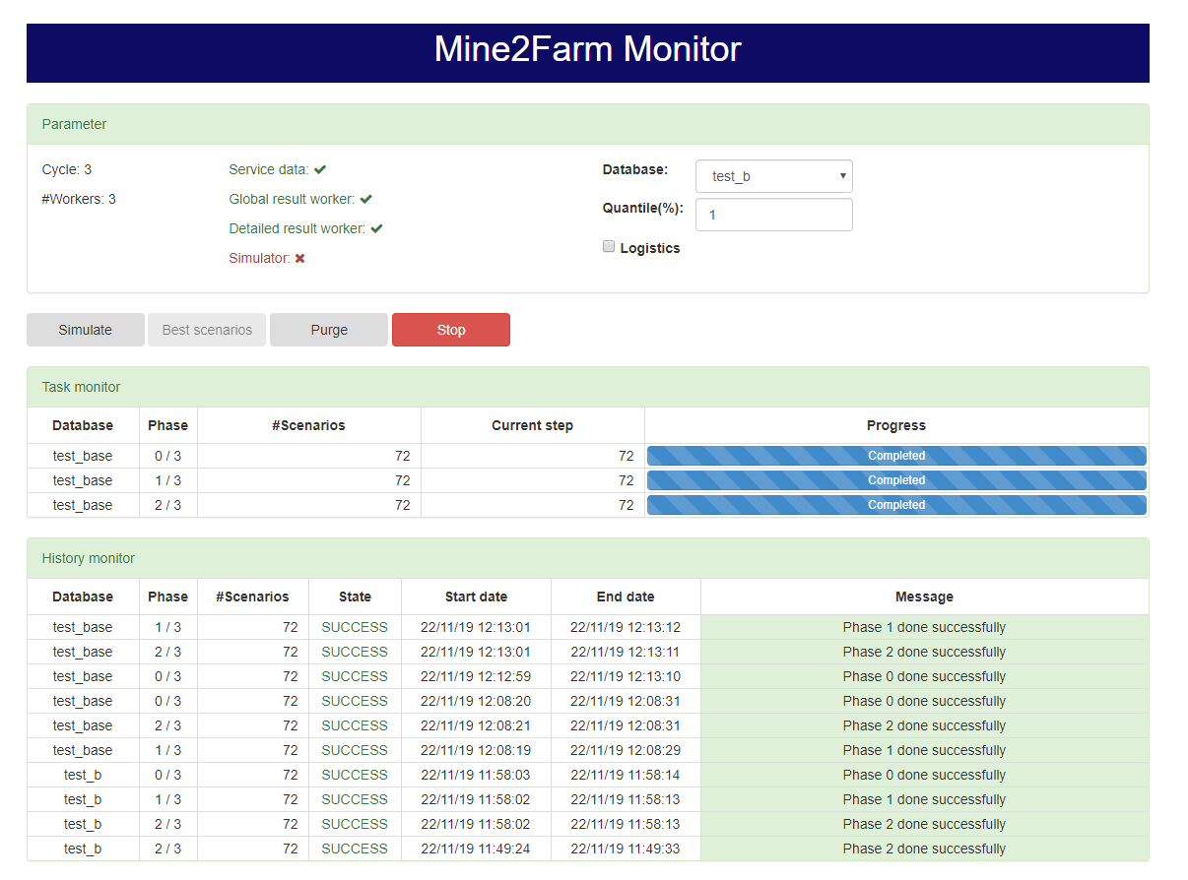
Monitor

Slide 65
Workers Dashboard monitoring
Parameter
Once you select the database and also the quantile step
Simulate
Press Simulate to start the simulation
Task monitor
Shows progress status of simulation step
History monitor
Gives steps status and if it’s on Failure, we show the error message

Slide 66
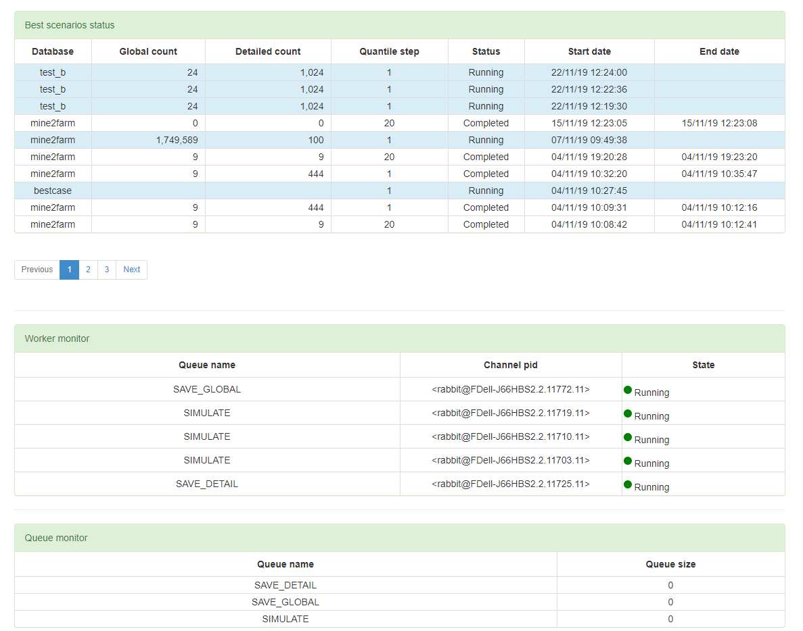
Best scenarios
Shows the start and end date per best scenario
Worker monitor
Shows running worker
Queue monitor
Shows number of waiting worker

Slide 67
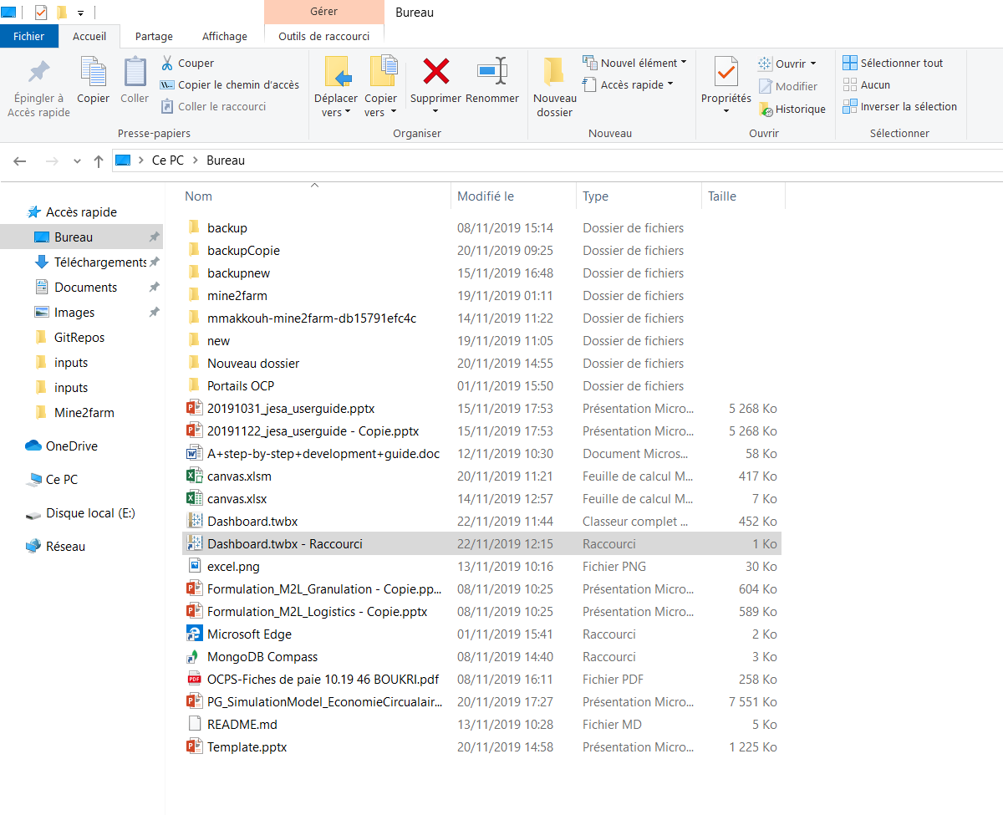
Dahboard

Slide 68
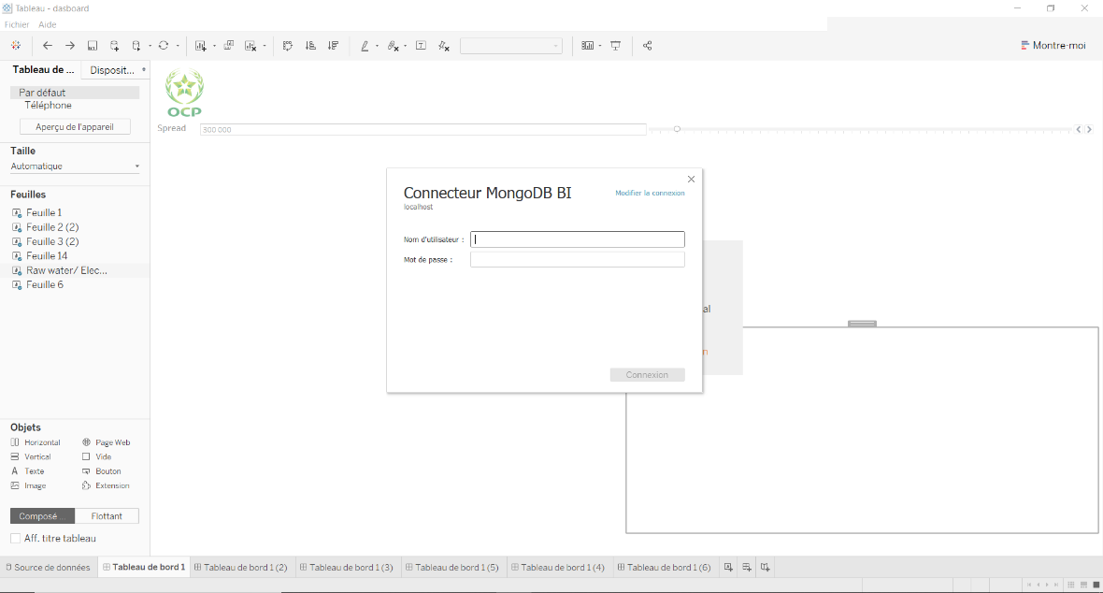
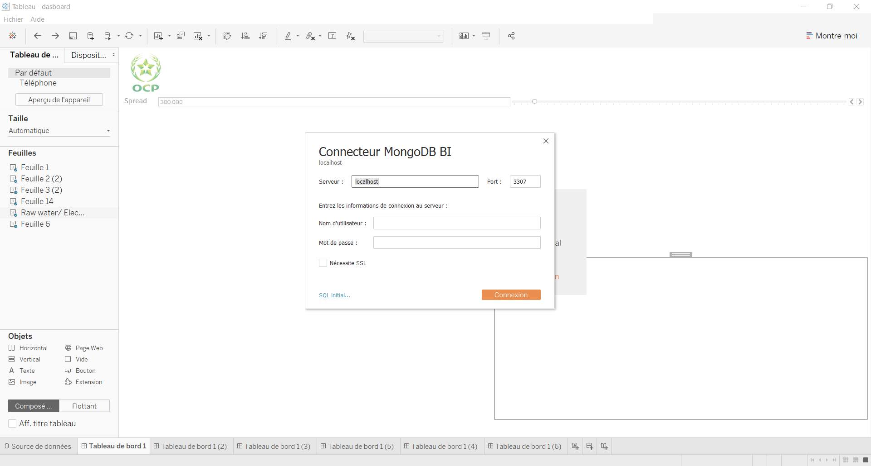
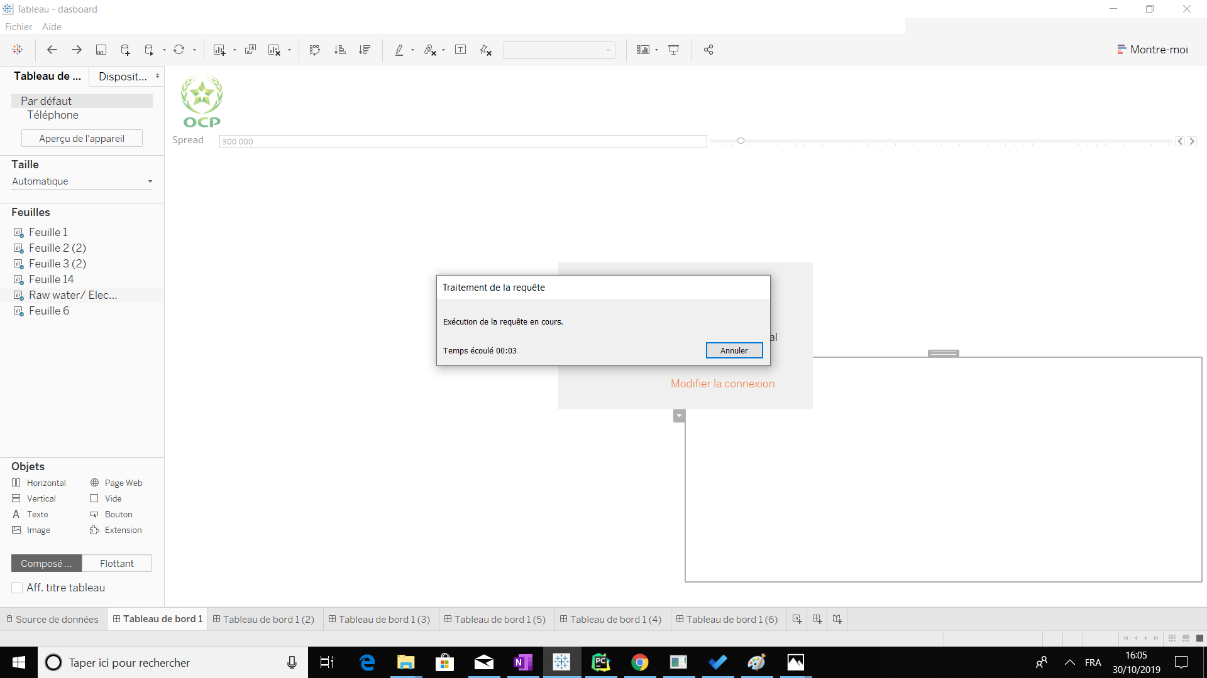
How to connect to MongoDB
Server: 172.29.161.208
Port: 3307

Slide 69
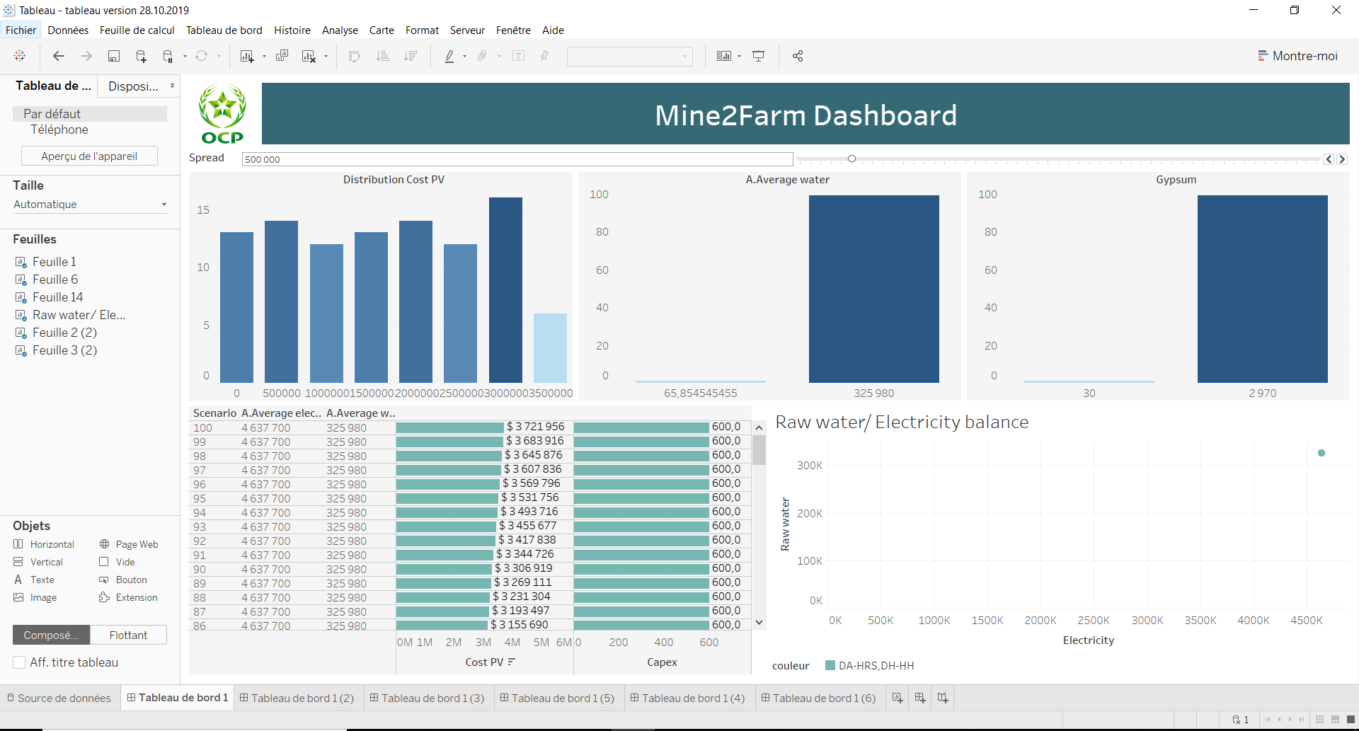
How to configure your database
Go to « Source de données » to configure your database

Slide 70
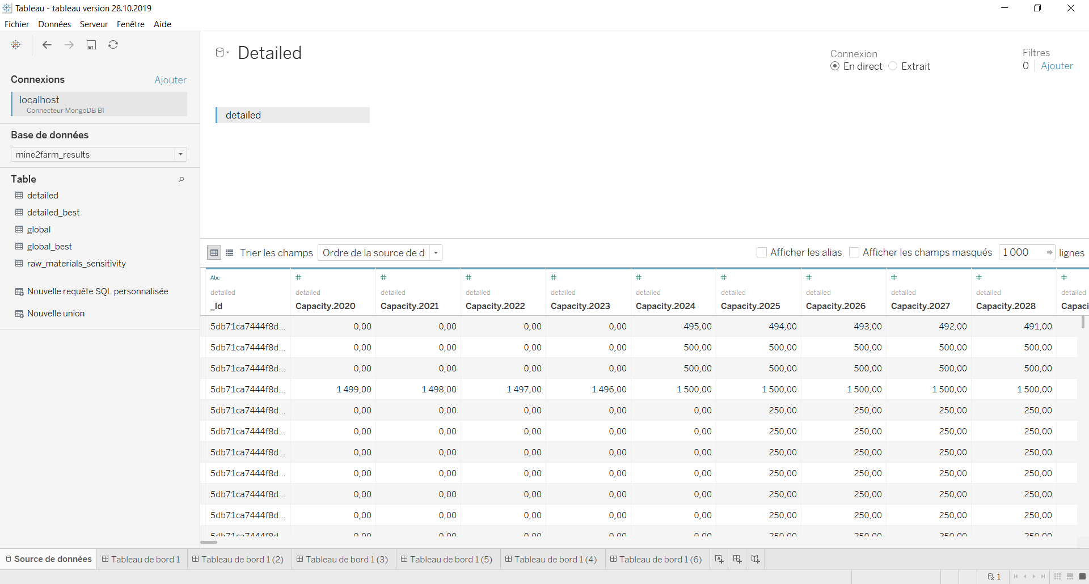
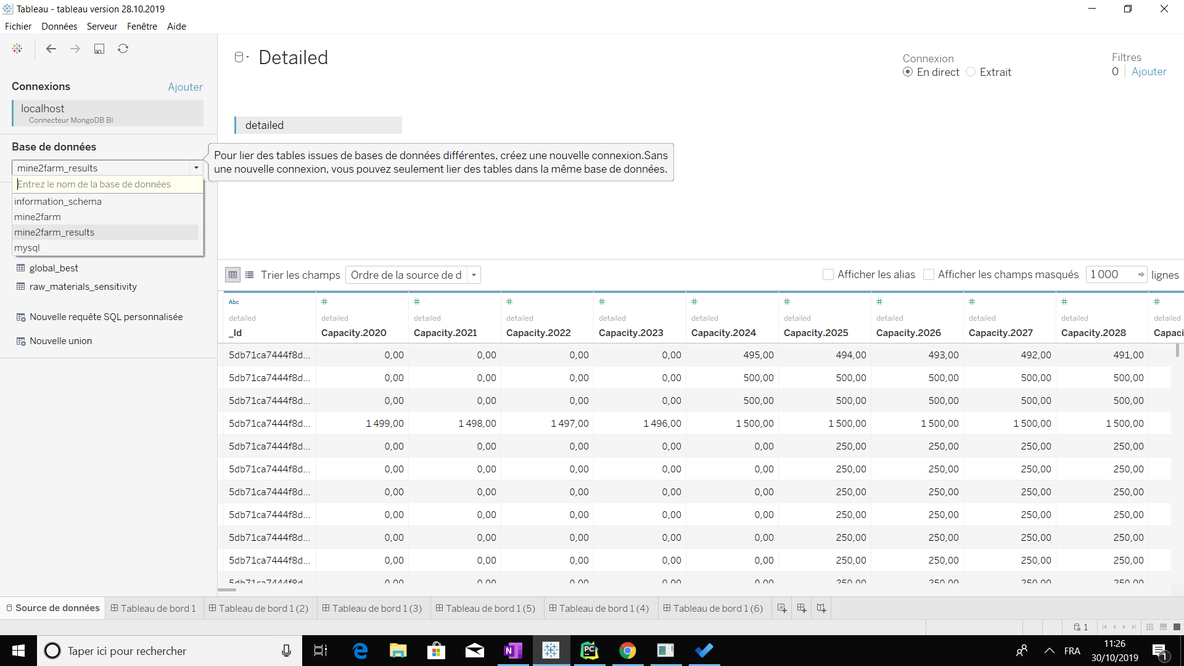
How to configure your database
You can modify the data using the refresh button
It allows you to choose your database

Slide 71
Use presentation mode to display all designed

Slide 72
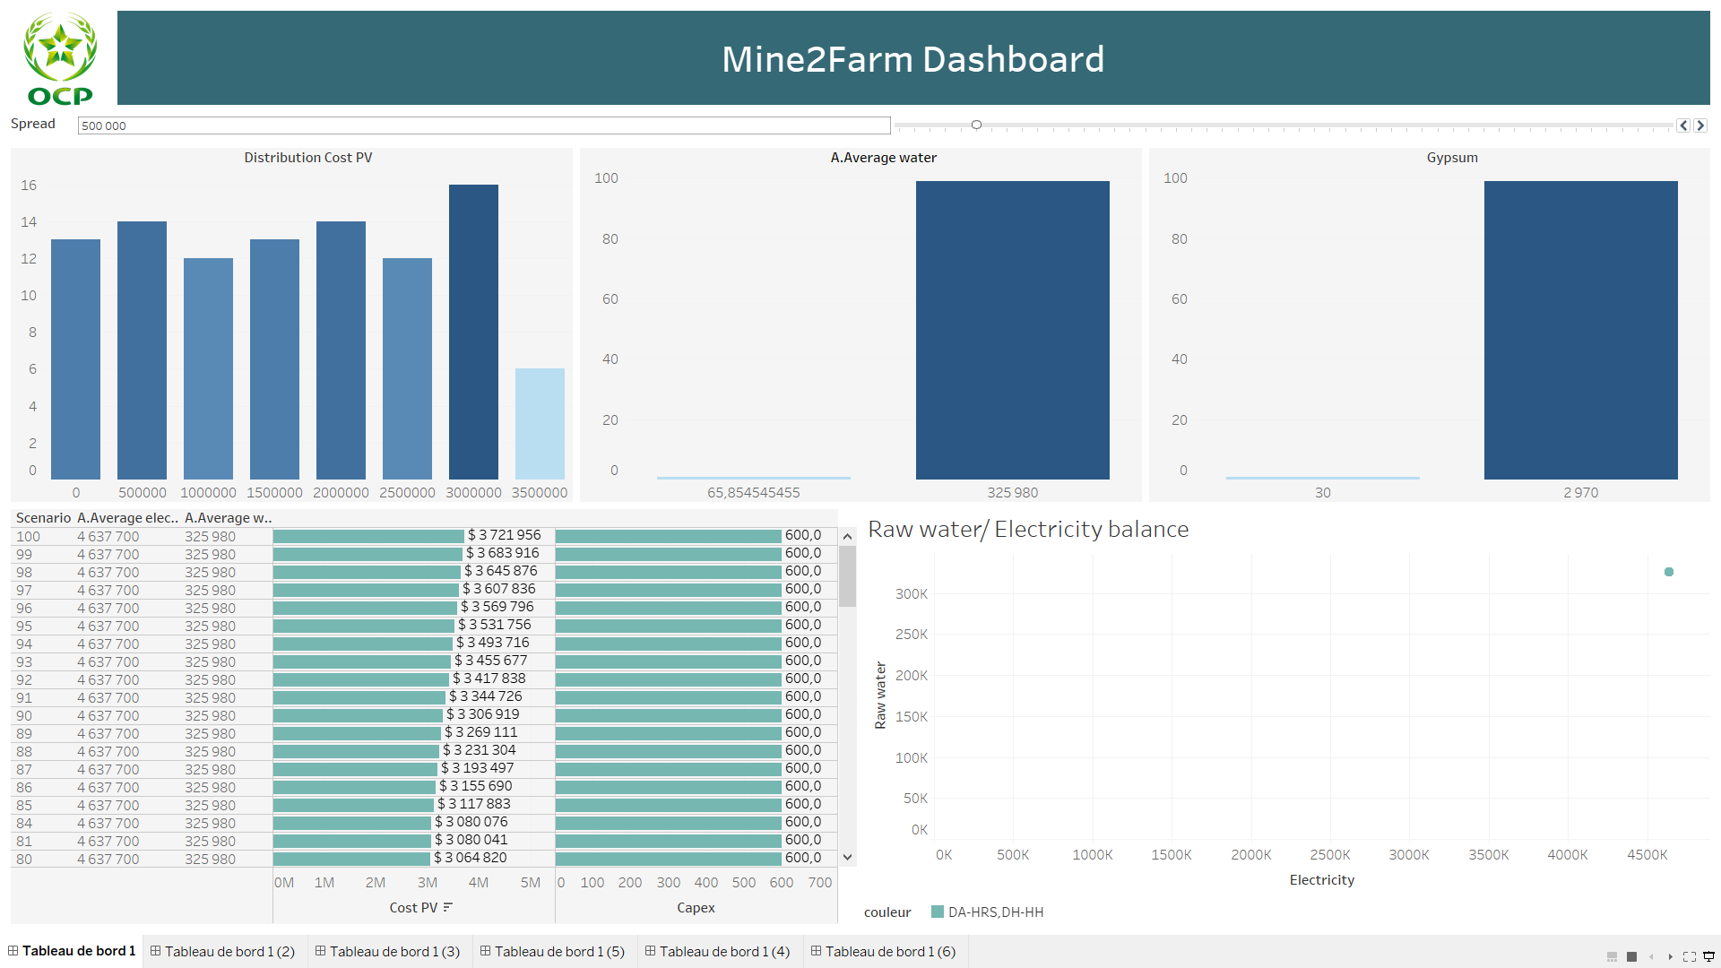
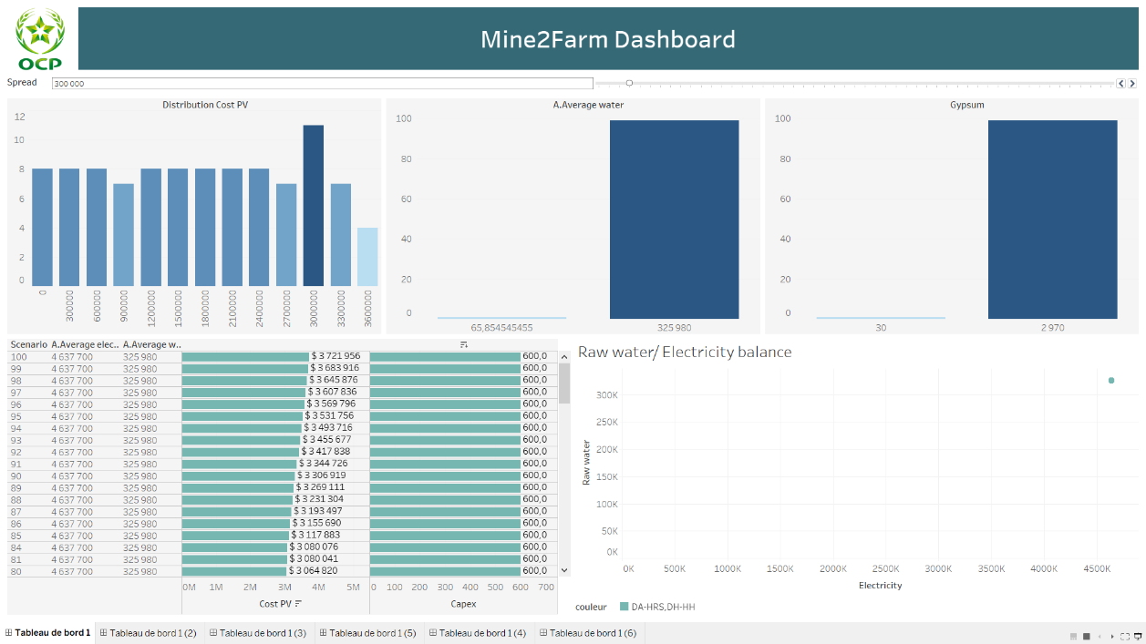

1
The cost PV distribution per scenario
2
Raw water average distribution for all layer per scenario
1
2
3
Gypsum production distribution per scenario
3
Ordered display of cost and Capex
4
consumption of raw water and electricity per scenario
4
5
5
1- You can reduce the spread for more details
2- You can order Cost PV and Capex par using this filter

Slide 73
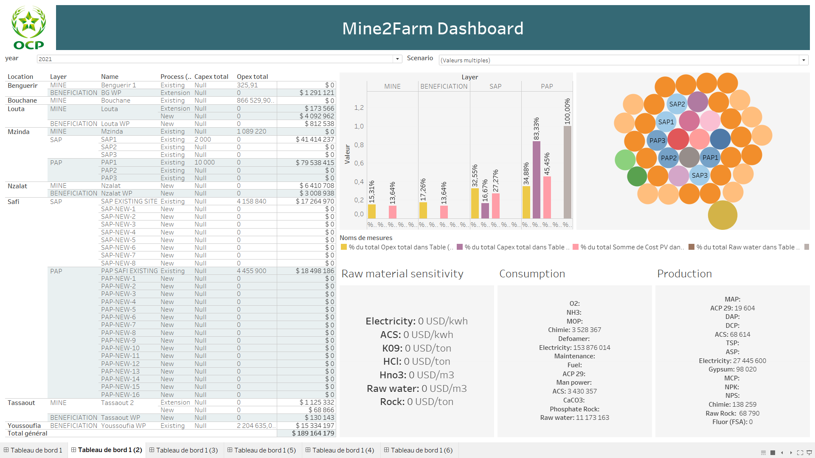
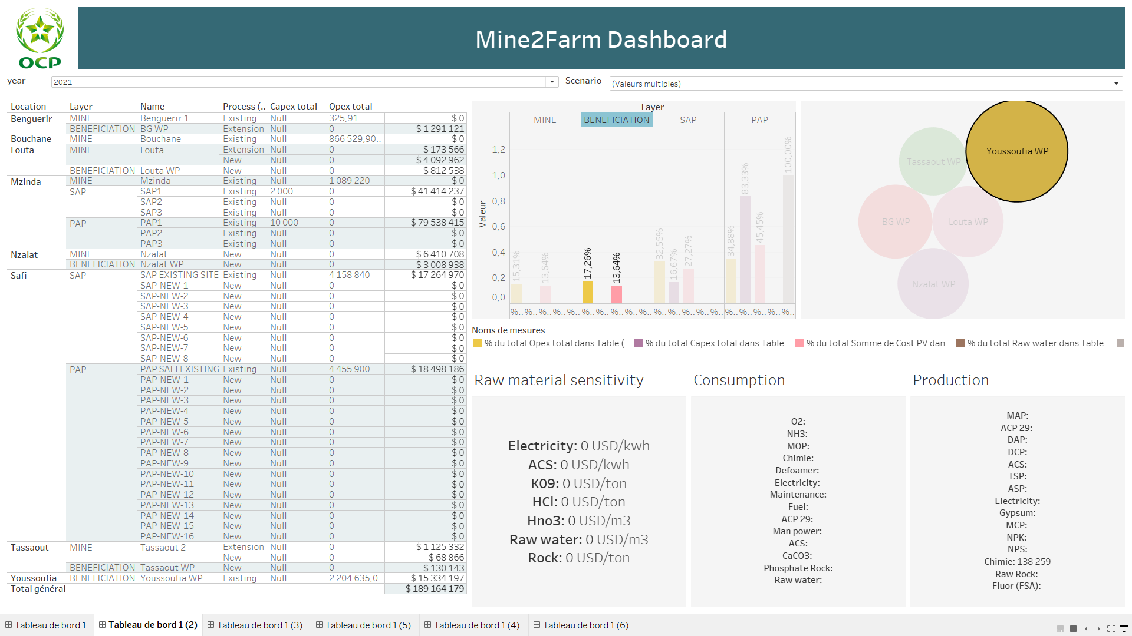
1
Show information about localisaation , Entity , CAPEX , OPEX and Cost PV and also Global cost PV
2
% of OPEX,CAPEX,Cost PV Water and Gypsum per global consumption of scenario and this for each Layer
2
3
Sizing of each entity ( Cost PV per scenario)
3
1- 2 and 3 are filters of 4-5-6
2- Scenario and Year are global filters
1
4
5
6
4
Sensibility display per Raw Water
5
All product that were consumded
Consumption of production
6

Slide 74
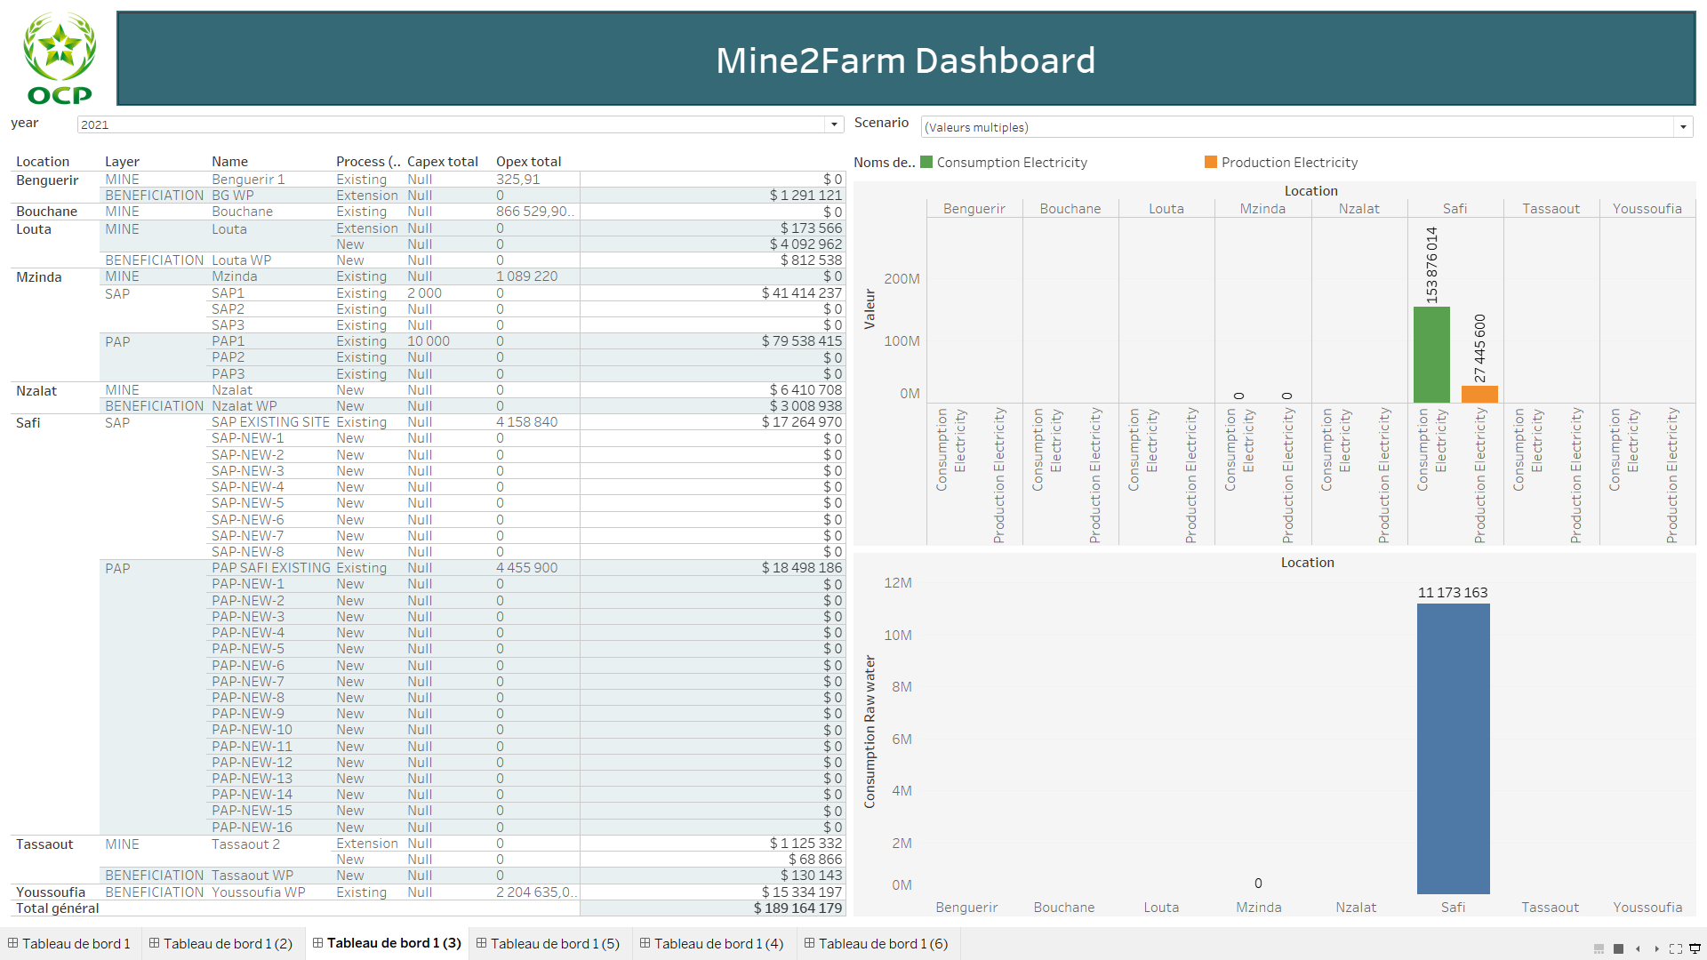
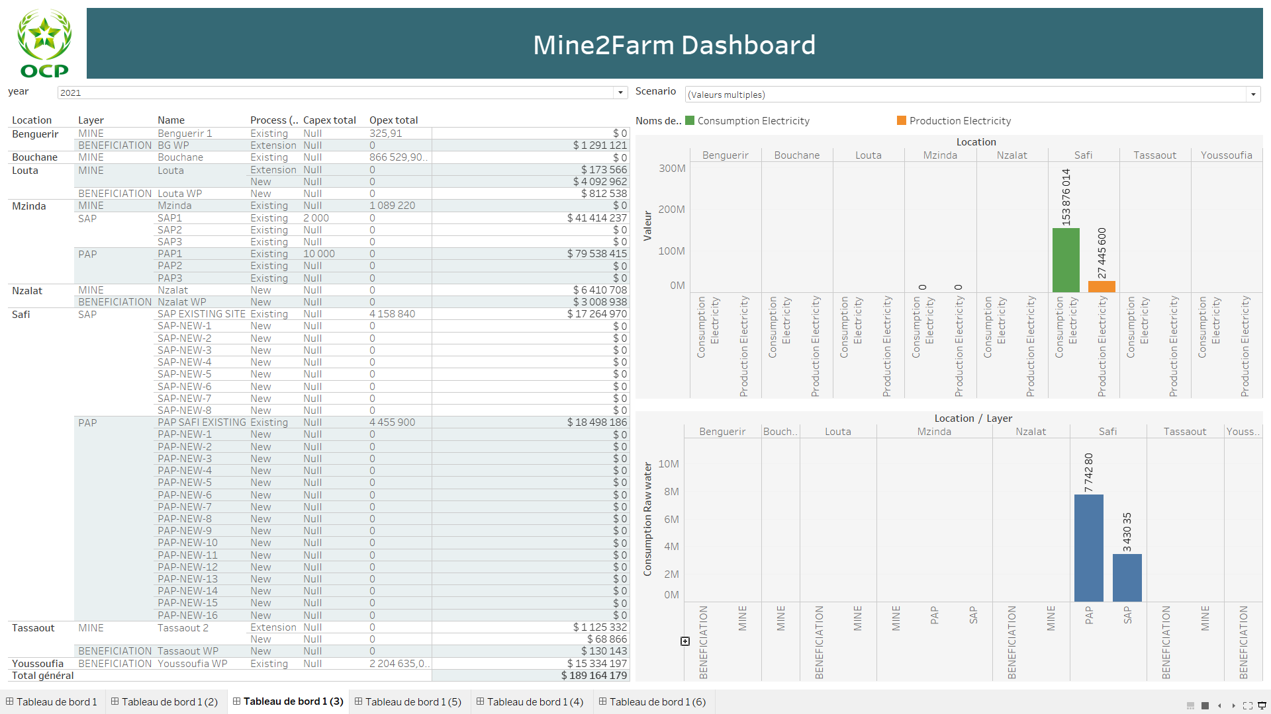
Show information about localisaation , Entity , CAPEX , OPEX and Cost PV and also Global cost PV
1
2
Raw water and Electricity consumption per scenario
Water consumption
3
You can have more locations , Layer and Entity with

Slide 75
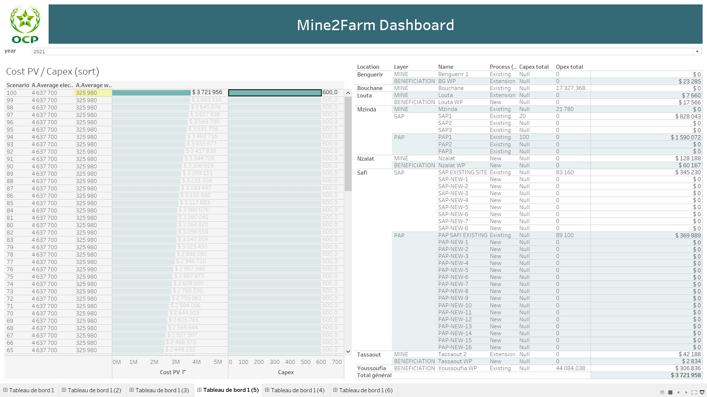
You can choose the scenario directly from the table

Slide 76
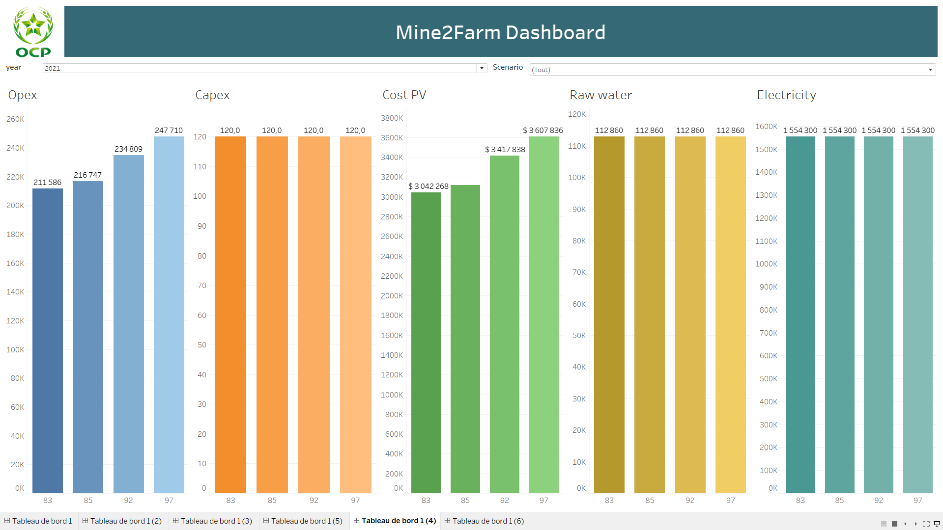
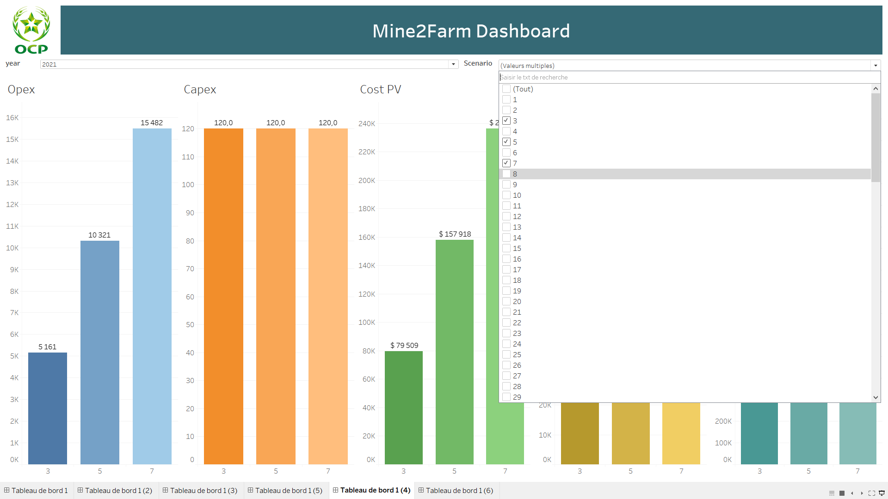
You can choose the desired nomber of scenario to display results

Slide 77
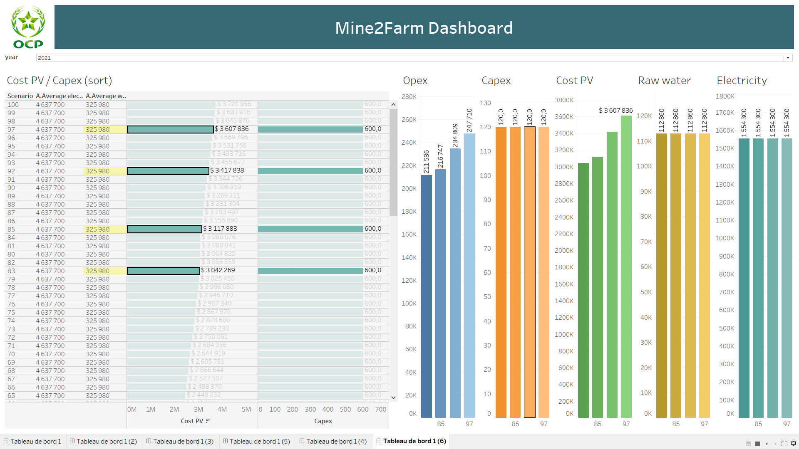
Use Ctrl + click to select the desired elements to display per OPEX , CAPEX, Cost PV, Raw Water, Electricity

